Slide 1
RSA (Rivest-Shamir-Adleman) ALGORITHM
An Asymmetric Key Algorithm

Slide 2
Presentation Overview
Introduction
RSA Algorithm
Mathematics Behind RSA
Attacks on RSA
Conclusion

Slide 3
INTRODUCTION
Proposed by Rivest, Shamir & Adleman of MIT in 1977
Best known & widely used public-key scheme
Uses large numbers (1024 bits, 2048 bits )
Uses two different but mathematically linked keys - one public and one private.
The public key can be shared with everyone, whereas the private key must be kept secret.

Slide 4
Why RSA Algorithm ?
Derives its security from the difficulty of factoring large integers that are the product of two large prime numbers.
Either of the two related keys can be used for encryption, with the other used for decryption. So, it can be used for both confidential communications and generating digital signatures.

Slide 5
RSA Key Setup
Each user generates a public / private key pair by selecting two large prime numbers at random: p, q [As an example, let, p=7 and q=17]
Compute their system modulus n=p.q [n=7.17=117]
Compute Euler Totient function ø(n)=(p-1)(q-1) [ø(n)=6.16=96]
Select at random the encryption key e [Let, e=5 because it is not a factors of 96]
Such that 1<e<ø(n), gcd(e,ø(n))=1
Solve the following equation to find decryption key d [(77.5) mod 96=1. So, d=77]
e.d=1 mod ø(n) and 0≤d≤n {Equivalently, (d.e) mod (p-1).(q-1)=1}
Publish public encryption key: {e,n} [{5,117}]
Keep secret private decryption key: {d,n} [{77,117}]

Slide 6
RSA Encryption / Decryption
To encrypt a message M the sender:
obtains public key of recipient {e,n}
computes: C = Me mod n, where 0≤M<n
To decrypt the ciphertext C the owner:
uses their private key {d,n}
computes: M = C^{d} mod n
Note that the message M must be smaller than the modulus n

Slide 7
Mathematics Behind RSA

Slide 8
Euler’s Totient Function
The number of positive integers less than n and relatively prime to n .
By convention Φ(1) = 1 .
To determine Φ(35) , we list all of the positive integers less than 35 that are relatively prime to it:
1, 2, 3, 4, 6, 8, 9, 11, 12, 13, 16, 17, 18,19, 22, 23, 24, 26, 27, 29, 31, 32, 33, 34
There are 24 numbers on the list, so Φ(35) = 24 .
for a prime number p , Φ(p) = p - 1
Φ(n) = Φ(pq) = Φ(p) * Φ(q) = (p - 1) * (q - 1)

Slide 9

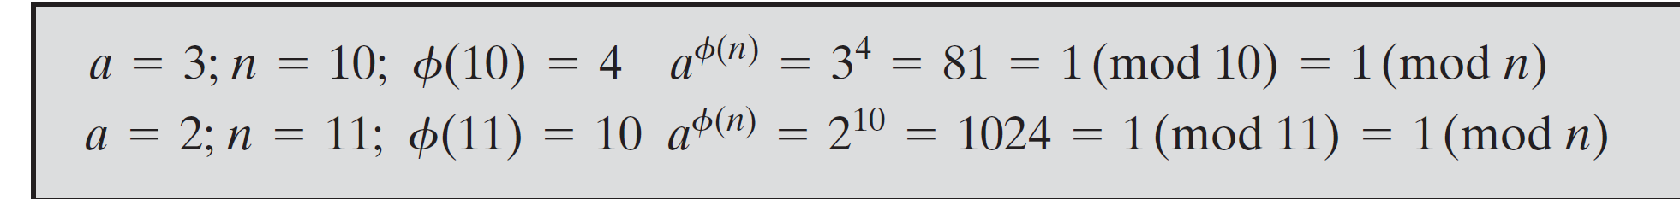
Euler’s Theorem
Euler’s theorem states that if n is a positive integer and a, n are co-prime, then

Slide 10
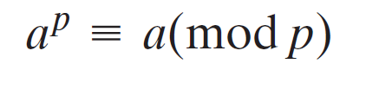
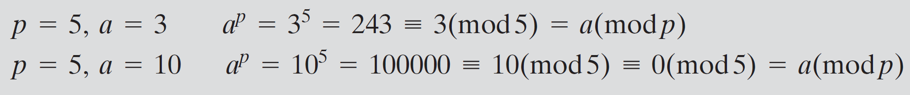
Fermat's Little Theorem
It is a fundamental theorem in elementary number theory, which helps compute powers of integers modulo prime numbers.
If p is prime and a is a positive integer not divisible by p, then
a^{p - 1}≡ 1 (mod p)
If p is prime and a is a positive integer, then

Slide 11
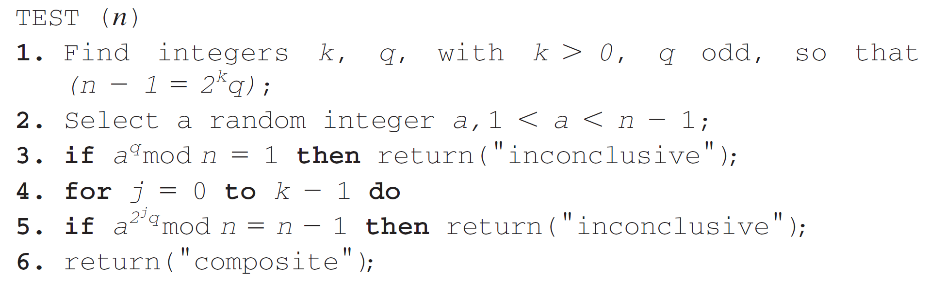
TESTING FOR PRIMALITY
Miller-Rabin Algorithm

Slide 12
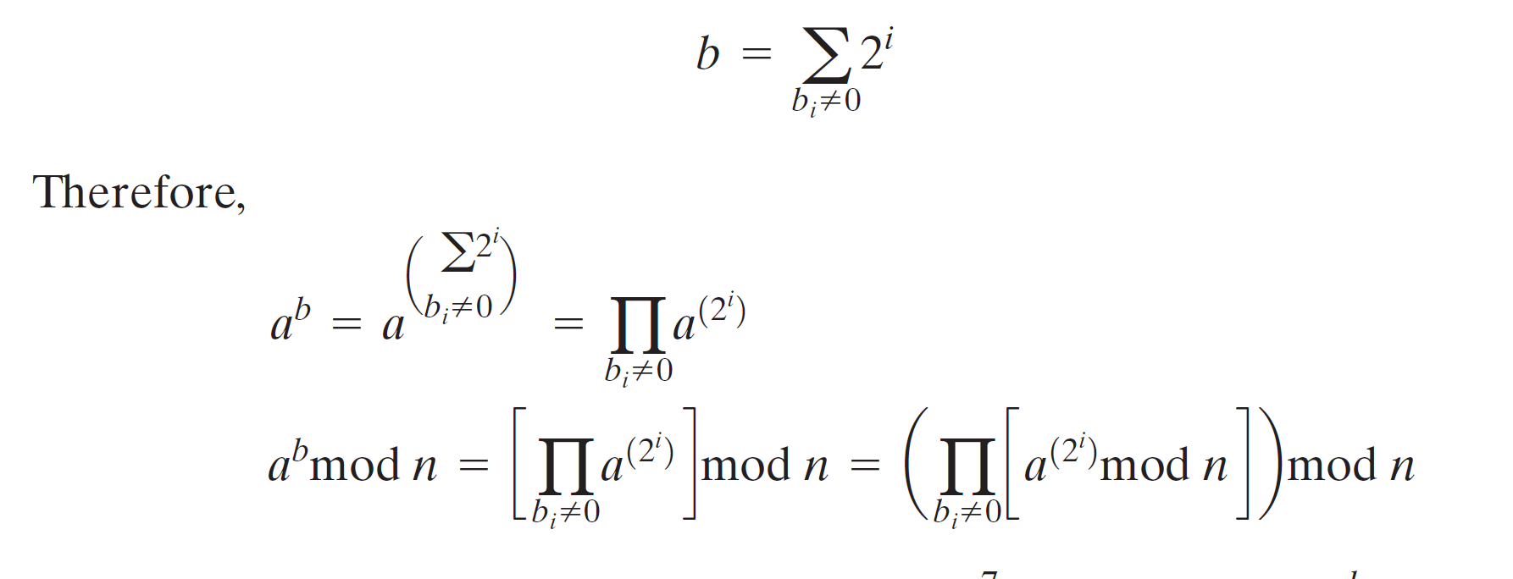
EXPONENTIATION
Both encryption and decryption in RSA involve raising an integer to an integer power, mod n.
To find the value a^{b} with a and b positive integers. If we express b as a binary number b_{k} b_{k-1}... b_{0,} then we have

Slide 13
RSA Key Generation
Step 1: Determining two prime numbers, p and q.
1. Pick an odd integer n at random (e.g., using a pseudorandom number generator).
2. Pick an integer a < n at random.
3. Perform the probabilistic primality test, such as Miller-Rabin, with a as a parameter.
If n fails the test, reject the value n and go to step 1.
4. If n has passed a sufficient number of tests, accept n; otherwise, go to step 2.

Slide 14
RSA Key Generation Contd.
The prime number theorem states that the primes near N are spaced on the average one every (ln N) integers.
Thus, on average, one would have to test on the order of ln(N) integers before a prime is found.

Slide 15
RSA Key Generation Contd.
Step 2- Selecting either e or d and calculating the other.
we need to select an e such that gcd(Φ(n), e) = 1 and then calculate d≡e⁻¹ (mod Φ(n)).
We use extended Euclid’s algorithm.
It calculates the greatest common divisor of two integers and, if the gcd is 1, determine the inverse of one of the integers modulo the other
The procedure is to generate a series of random numbers testing each against Φ(n) until a number relatively prime to f(n) is found.
The probability that two random numbers are relatively prime is about 0.6;

Slide 16
Efficient Encryption
encryption uses exponentiation to power e
hence if e small, this will be faster
often choose e=65537 (216-1)
also choices of e=3 or e=17
but if e too small (eg e=3) becomes vulnerable to a simple attack
using Chinese remainder theorem & 3 messages with different module
if e fixed must ensure gcd(e,ø(n))=1
i.e reject any p or q not relatively prime to e

Slide 17
Efficient Decryption
decryption uses exponentiation to power d
this is likely large, insecure if not
can use the Chinese Remainder Theorem (CRT) to compute mod p & q separately. then combine to get desired answer
approx 4 times faster than doing directly
only owner of private key who knows values of p & q can use this technique

Slide 18
Attacks on RSA

Slide 19
Attacks on RSA Algorithm
At the moment RSA seems to be extremely secure. It has survived over 20 years of scrutiny and is in widespread use throughout the world. The attack that is most often considered for RSA is the factoring of the public key. If this can be achieved, all messages written with the public key can be decrypted. The point is that with very large numbers, factoring takes an unreasonable amount of time. It has not been proven that breaking the RSA algorithm is equivalent to factoring large numbers (there may be another, easier method), but neither has it been proven that factoring is not equivalent.

Slide 20
The Security of RSA
Brute force: To try all possible private keys.
infeasible given size of numbers
Mathematical attacks: There are several approaches, all equivalent in effort to factoring the product of two primes.
based on difficulty of computing ø(n), by factoring modulus n
Timing attacks: depend on the running time of the decryption algorithm.
Chosen ciphertext attacks: This type of attack exploits properties of the RSA algorithm.

Slide 21
Brute Force
The defense against the brute-force approach is the same for RSA as for other cryptosystems, namely, use a large key space.Thus, the larger the number of bits in d, the better. However, because the calculations involved, both in key generation and in encryption/decryption, are complex, the larger the size of the key, the slower the system will run.

Slide 22
The Factoring Problem
We can identify three approaches to attacking RSA mathematically:
Factor n into its two prime factors. This enables calculation of phi(݊n)=(p -1)*( q-1), which, in turn, enables determination of ݁d=e⁻¹mod(phi)
Determine phi(n) directly, without first determining p and q. Again, this enables determination of݁ d=e⁻¹mod(phi)
Determine d directly, without first determining phi(n).

Slide 23
Factoring Problem(Contd.)
Determining phi(n) given n is equivalent to factoring n. With presently known algorithms, determining d given e and n appears to be at least as time-consuming as the factoring problem. Hence, we can use factoring performance as a benchmark against which to evaluate the security of RSA.
To avoid values of n that may be factored more easily, the algorithm's inventors suggest the following constraints on p and q:
p and q should differ in length by only a few digits. Thus, for a 1024-bit key (309 decimal digits), both p and q should be on order of 10^75 to 10^100.
Both (p – 1) and (q – 1) should contain a large prime factor
gcd(p–1, q–1) should be small.

Slide 24
Timing Attacks
Timing Attacks demonstrated that a snooper can determine a private key by keeping track of how long a computer takes to decipher messages.
Timing Attacks are based on observing how long it takes to compute the cryptographic operations. Timing attacks are applicable not just to RSA, but to other public-key cryptography systems.
This attack is alarming for two reasons: It comes from a completely unexpected direction and it is a ciphertext-only attack

Slide 25
Counter measures against Timing Attacks
Constant exponentiation time:Ensure that all exponentiations take the same amount of time before returning a result. This is a simple fix but does degrade performance.
Random delay:Better performance could be achieved by adding a random delay to the exponentiation algorithm to confuse the timing attack. Kocher points out that if defenders don't add enough noise, attackers could still succeed by collecting additional measurements to compensate for the random delays.
Blinding:Multiply the ciphertext by a random number before performing exponentiation. This process prevents the attacker from knowing what ciphertext bits are being processed inside the computer and therefore prevents the bit-by-bit analysis essential to the timing attack.

Slide 26
Chosen Ciphertext Attack
The RSA algorithm is vulnerable to a chosen ciphertext attack (CCA).
CCA is defined as an attack in which adversary chooses a number of ciphertexts and is then given the corresponding plaintexts, decrypted with the target’s private key.
The adversary exploits properties of RSA and selects blocks of data that, when processed using the target’s private key, yield information needed for cryptanalysis.
More sophisticated variants need to modify the plaintext using a procedure known as optimal asymmetric encryption padding (OAEP).

Slide 27
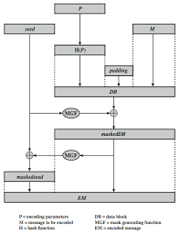
Counter Chosen Ciphertext Attack
To counter such attacks RSA Security, a leading RSA vendor and former holder of the RSA patent, recommends modifying the plaintext using a procedure known as optimal asymmetric encryption padding (OAEP).

Slide 28
Counter Chosen Cipher Attack (contd.)
As a first step the message M to be encrypted is padded. A set of optional parameters P is passed through a hash function H.
The output is then padded with zeros to get the desired length in the overall data block (DB). Next, a random seed is generated and passed through another hash function, called the mask generating function (MGF).
The resulting hash value is bit-by-bit XORed with DB to produce a maskedDB.
The maskedDB is in turn passed through the MGF to form a hash that is XORed with the seed to produce the masked seed.
The concatenation of the maskedseed and the maskedDB forms the encoded message EM.
Note that the EM includes the padded message, masked by the seed, and the seed, masked by the maskedDB. The EM is then encrypted using RSA.

Slide 29
Conclusion
RSA is the most popular public key encryption available today. It can be used both encryption and authentication. The security of RSA is related to the assumption that factoring is difficult.
RSA is built into current operating systems by Microsoft, Apple, Sun, and Novell. In hardware, RSA can be found in secure telephones, on Ethernet network cards. The estimated installed base of RSA encryption engines is around 20 million, making it by far the most widely used public key cryptosystem in the world.

Slide 30
Thank You

